Slide 1
Minimalism Conceptual Art Post-Minimalism

Slide 4
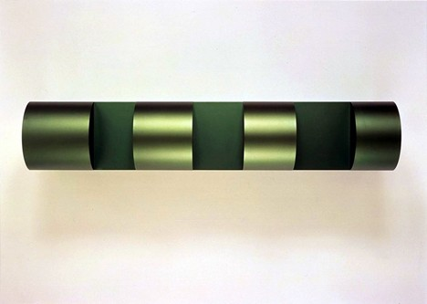
Donald Judd studied philosophy at Columbia and earned an MA in art history. He theorized his work in a 1965 essay, “Specific Objects,” as “non-relational” objects that supersede the traditions of painting and sculpture.
Untitled, 1967 Donald Judd

Slide 5
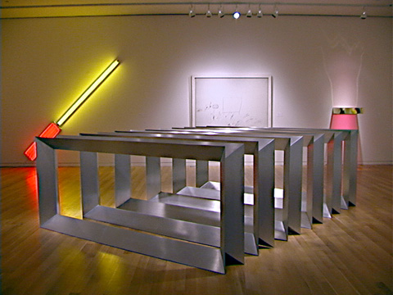
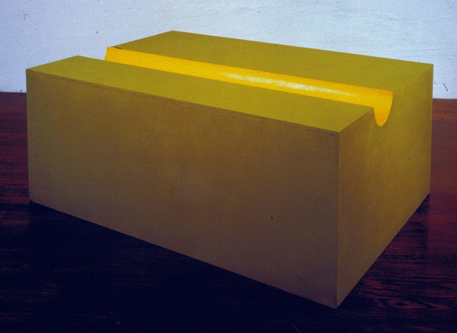
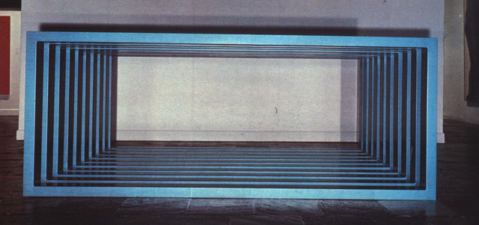
Donald Judd (US, Minimalist sculptor, 1928-1994), (left) Untitled, cold rolled steel, 1964 (right top) Judd, Untitled, 1978-9 six brushed aluminum hollow rectangles set at 14-inch intervals. (below right) Judd, Untitled, 1964, aluminum boxes
Non-relational, “literal” objects

Slide 6
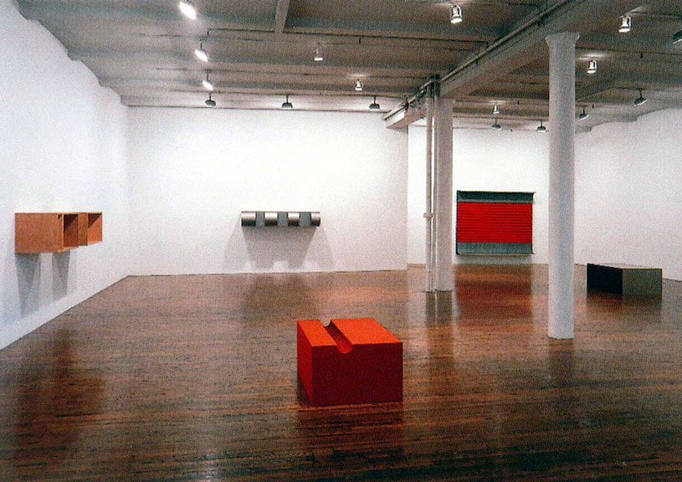
The essence of sculpture is its reliance on space: “a work can be as powerful as it can be thought to be. . . . Actual space is intrinsically more powerful and specific than paint on a flat surface.” Donald Judd
Theatricality of Minimalist sculpture

Slide 7
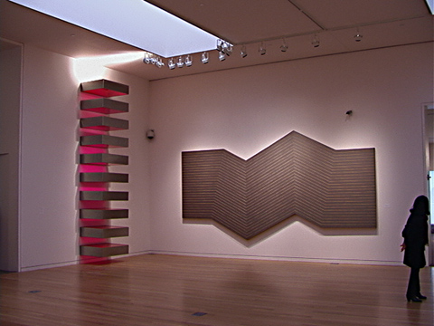
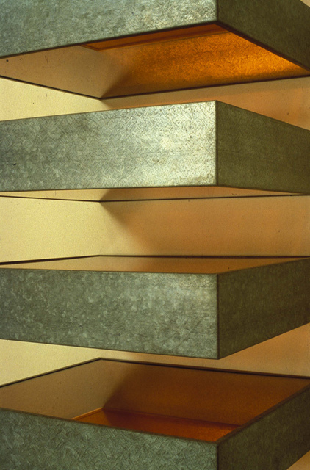
Sotheby art auction installation: (left), Donald Judd, Untitled, 1965, a stack of 10 stainless steel and red fluorescent plexiglass units stacked vertically in 9-inch intervals (right) Frank Stella, Nunca Pasa Nada, 1964, 110 x 220”, metallic powder in polymer emulsion on canvas
Detail of a stacked sculpture by Donald Judd

Slide 8
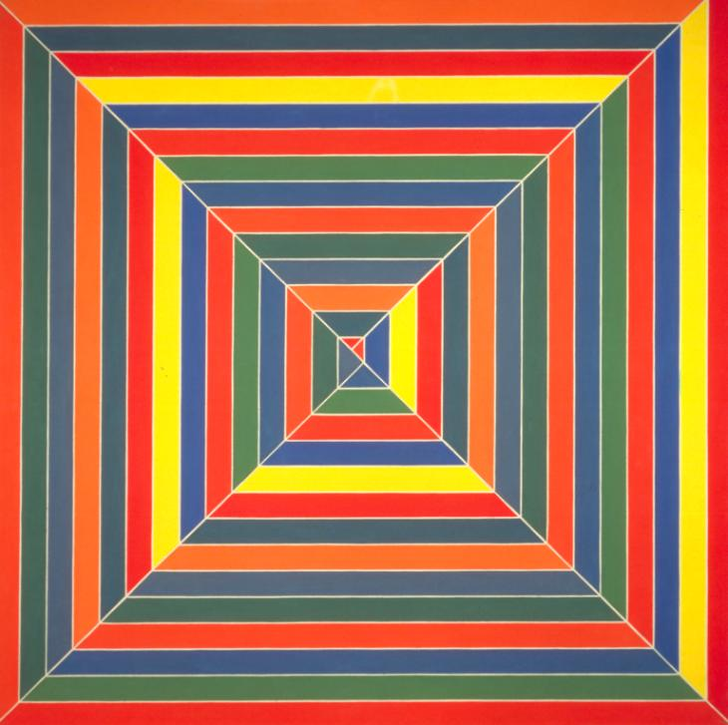
Frank Stella, acrylic on canvas, Hyena Stomp, 1962, Minimalism, Tate
“What you see is what you see.” (Stella)
For a helpful definition of Minimalism, go here: http://www.tate.org.uk/art/art-terms/m/minimalism

Slide 9
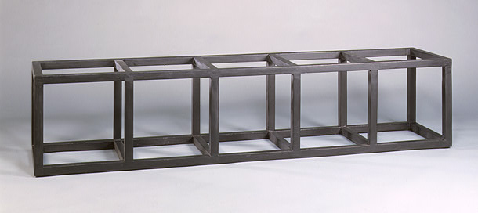
Sol LeWitt (American Minimalist Conceptual Artist, 1928-2007) Floor Structure Black, 1965, painted wood, 18 ½ x 18 x 82 in. Modular “structures” (not sculptures) originating from the cube. “Ideas can be works of art; they are in a chain of development that may eventually find some form. All ideas need not be made physical.” “Paragraphs on Conceptual Art,” 1969 (Minimal Art > Conceptual Art)

Slide 10
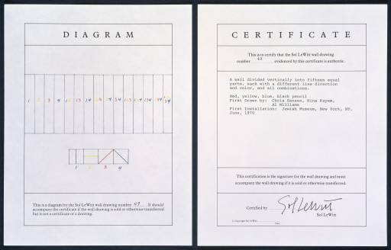
Lewitt, A Wall Divided Vertically into Fifteen Equal Parts, Each with a Different Line Direction and Color, and All Combinations 1970 "In conceptual art the idea or concept is the most important aspect of the work . . . all planning and decisions are made beforehand and the execution is a perfunctory affair. The idea becomes the machine that makes the art." Sol LeWitt: "Paragraphs on Conceptual Art," Artforum, summer issue, 1967

Slide 11
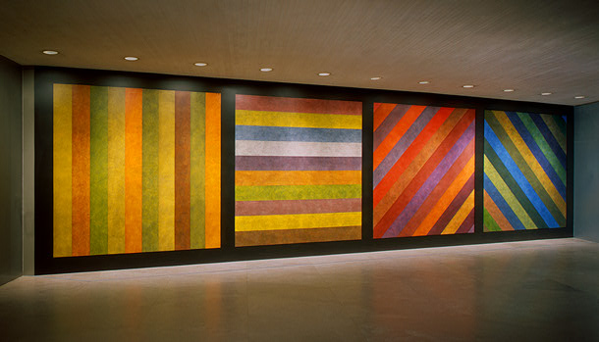
Sol LeWitt, Wall Drawing No. 681 C / A, 1993, Conceptual painting Instructions: wall divided vertically into four equal squares separated and bordered by black bands. Within each square, bands in one of four directions, each with color ink washes superimposed, 120 x 444 in.
http://www.nytimes.com/slideshow/2008/12/05/arts/1205-LEWI_index.html
Images from ongoing Lewitt show at Mass MoCA, opened in Spring, 2009, on view fo 8 years

Slide 12
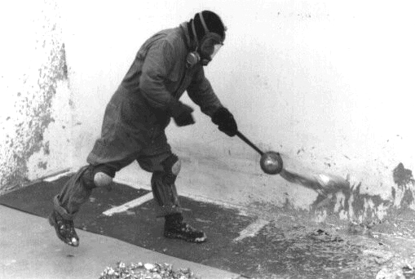
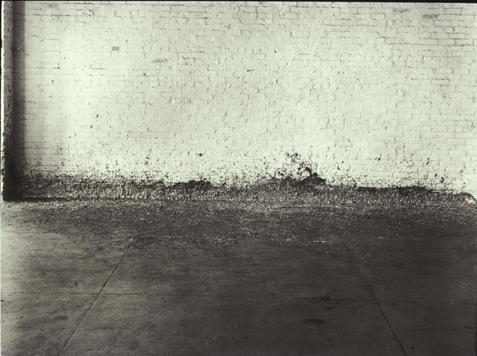
Richard Serra (b. 1939, US), Splashing, 1968, molten lead left to harden Post-Minimalism “Action” Sculpture in which the art is the process and the object is a record of the process.

Slide 13
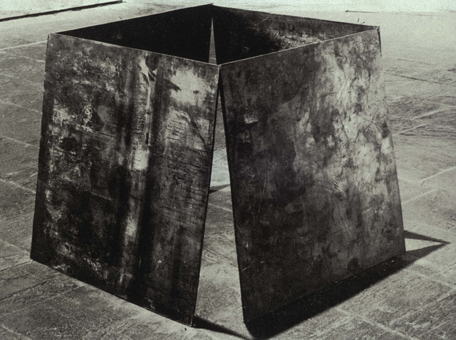
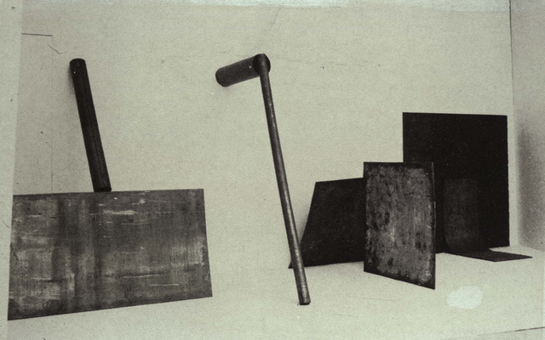
(left) Richard Serra, One-Ton Prop, 1969, Post-minimalism (right) installation, 1969 of Serra’s “prop” sculptures

Slide 14
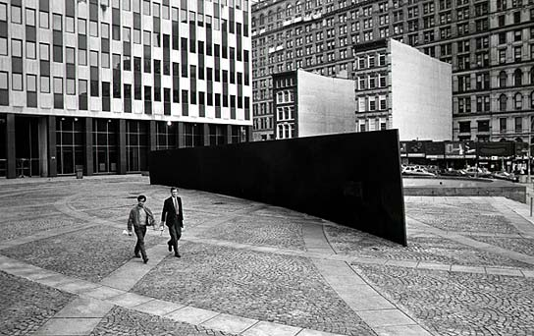
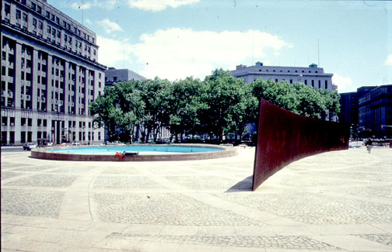
Richard Serra, Tilted Arc, Postminimalism, 12ft x 120 ft x 2.5 in, cor-ten steel, Federal Plaza, NYC, 1981-1989, Site-specific commissioned public artwork

Slide 15
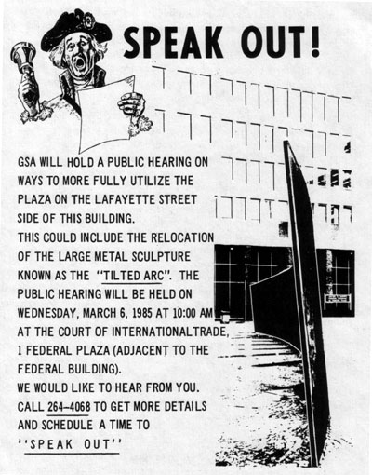
GSA = New York City General Services Administration

Slide 16
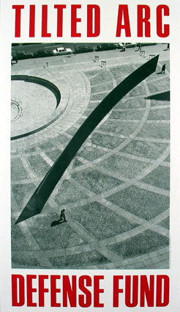
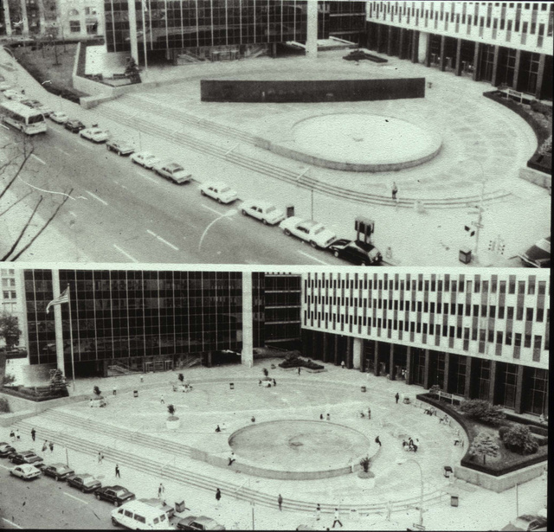
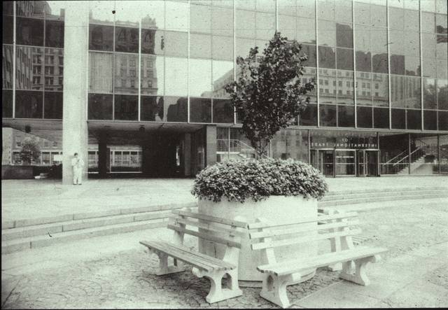
Document from legal
battle to retain sculpture
Federal Plaza, NYC, before (above) and after (below) removal of Tilted Arc with planters and benches

Slide 17
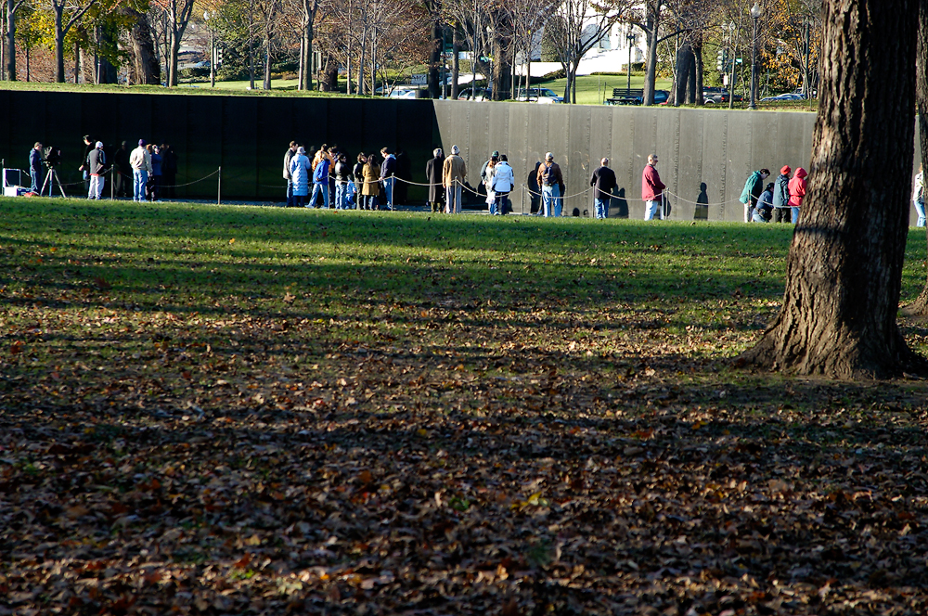
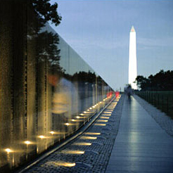
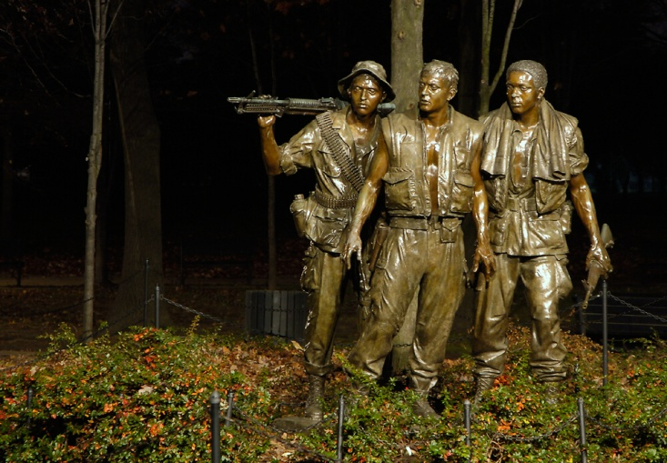
Maya Lin, Vietnam Veterans Memorial, polished black granite, 1982, Washington DC. (below left) Frederick Hart, Vietnam Veterans Memorial, 1984. Fills minimalist form with new democratic memorial content that subverts the idealization of the single heroic leader. Compare Washington obelisk, below right.

Slide 18
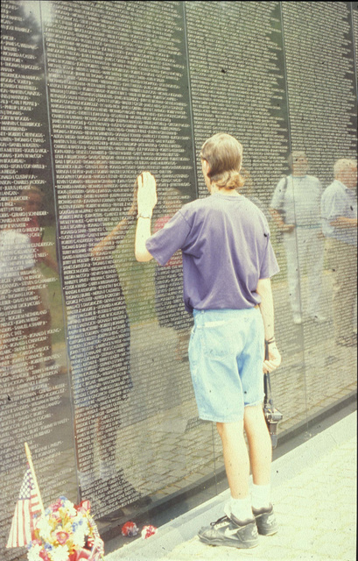

Slide 19
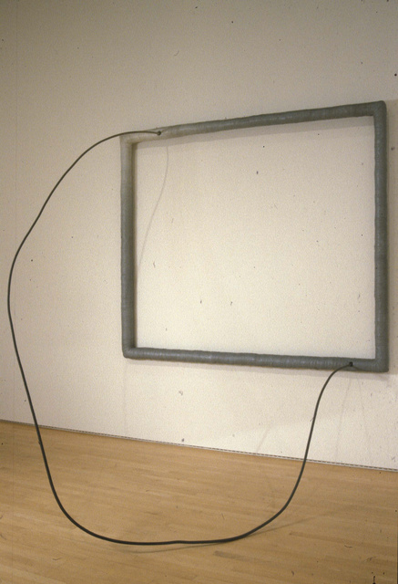
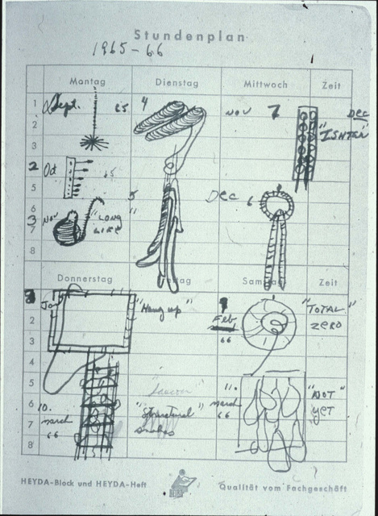
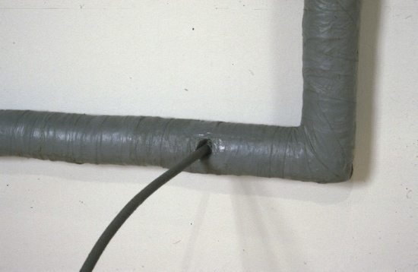
Eva Hesse Eva Hesse (American b. Germany, 1936-1970, 34 years), notebook page, 1965-66 (right), Hesse, Hang Up, acrylic on wood, cloth, steel, 1966
Detail

Slide 20
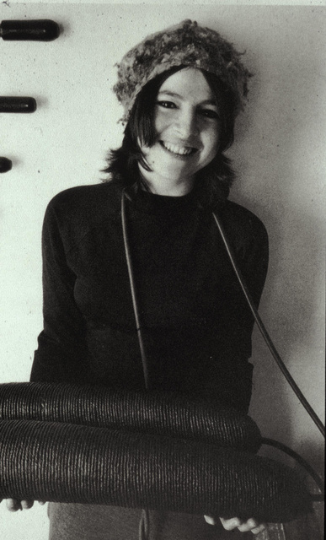
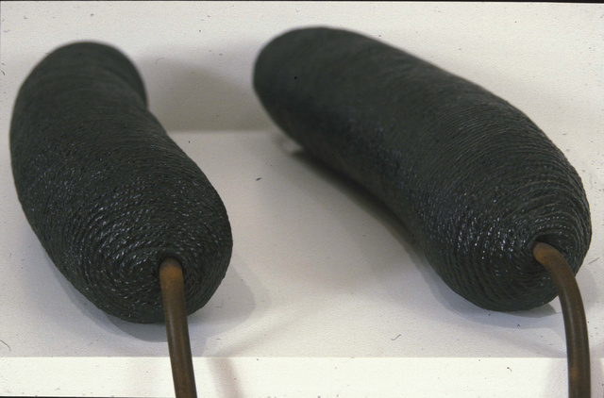
Hesse in New York apartment holding Ingeminate, 1966; Hesse Ingeminate 1965, surgical hose, papier-mâché, cord and sprayed enamel over balloons (detail)

Slide 21
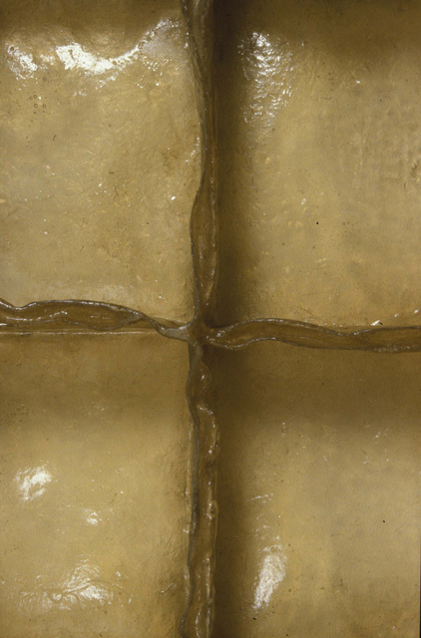
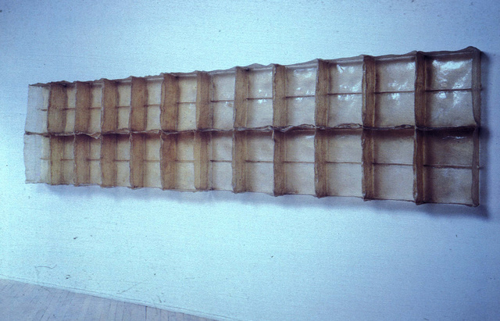
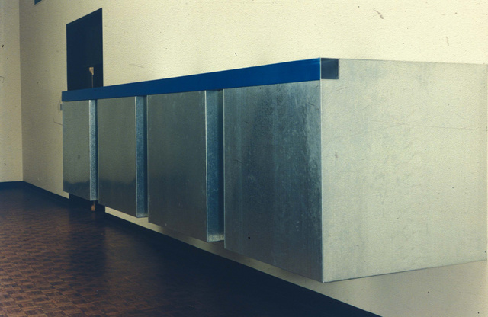
Hesse, Sans II (two views),1968 fiberglass polyester resin 5 units, each 38inH
detail
Compare Minimalist sculpture of
Donald Judd, Untitled, 1964

Slide 22
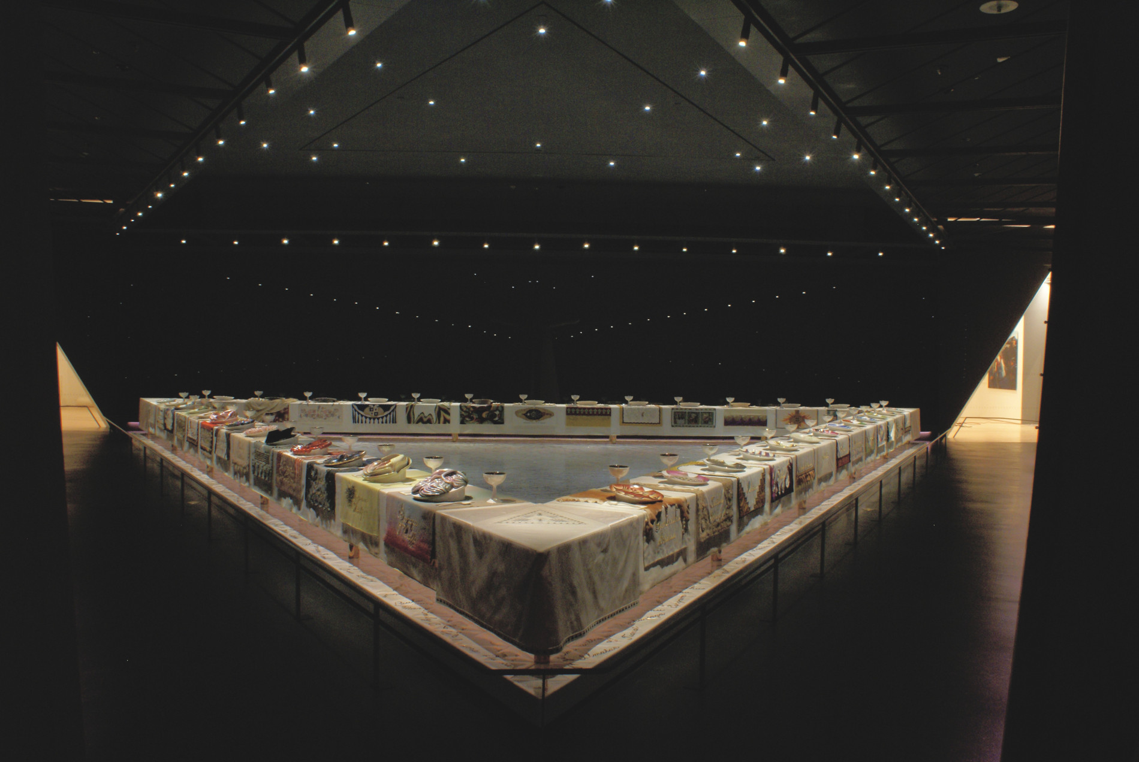
Judy Chicago (American, born 1939),The Dinner Party, 1974–79, ceramic, porcelain, textile, 576 × 576 in. Icon of feminist art on view permanently in Elizabeth A. Sackler Center for Feminist Art, Brooklyn MA, NYC. 39 place settings, 999 heritage floor tiles, each honoring a woman in history who made significant contributions to the lives of women

Slide 23
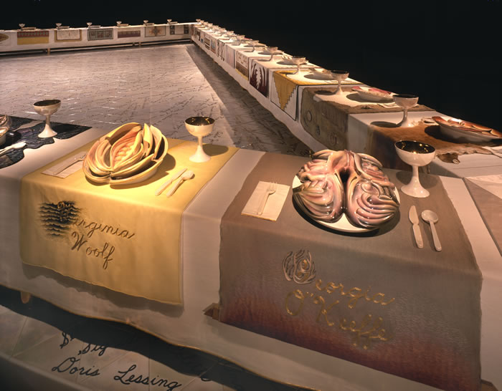
Detail of The Dinner Party installation showing place settings for writer Virginia Woolf and artist Georgia O’Keefe. Notice handmade embroidery, ceramic sculptures and floor tiles

Slide 24
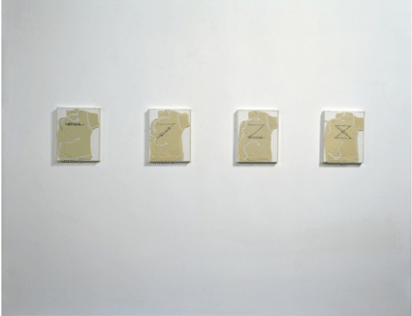
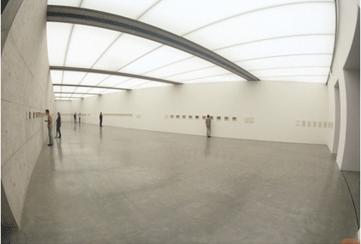
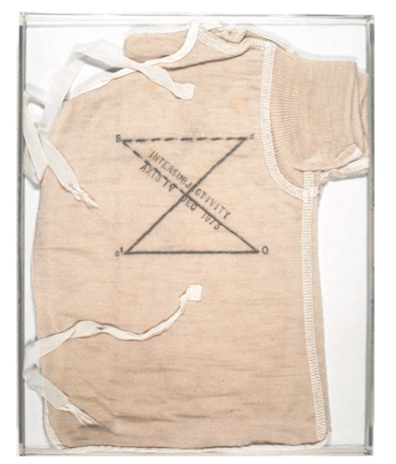
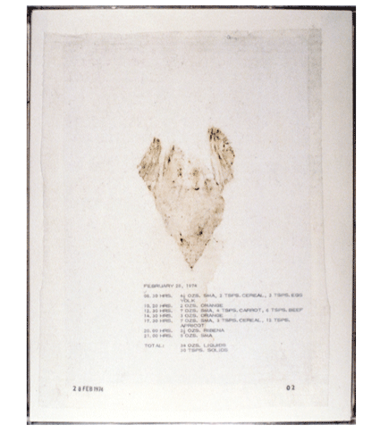
Mary Kelly (US b. 1941), Post-Partum Document, 1973-79. Installation in six parts. Installation View, Generali Foundation, Vienna Conceptual Art / Post-Minimalism (Right) Post-Partum Document: Introduction, 1973, Perpsex units, white card, wool vests, pencil, ink 4 units, 20 x 25.5 cm each. Wool baby shirt (bottom left) and diaper liner (bottom right)

Slide 25
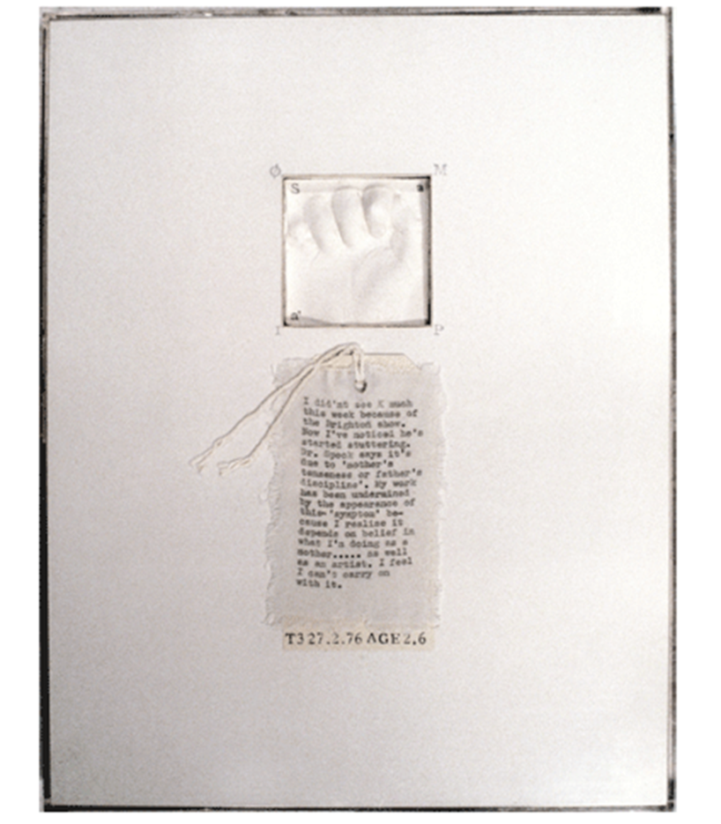
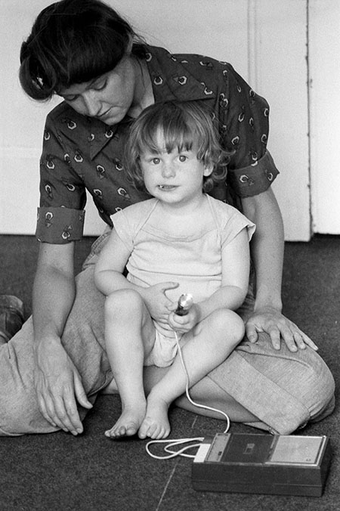
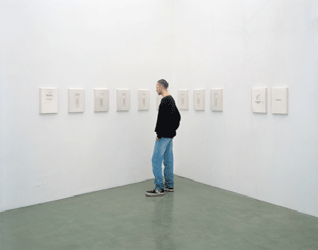
Mary Kelly, Post Partum Document, (left) detail of documentation panel, (center) Kelly and her son in a recording session for Post Partum Document, (right) viewer

Slide 26
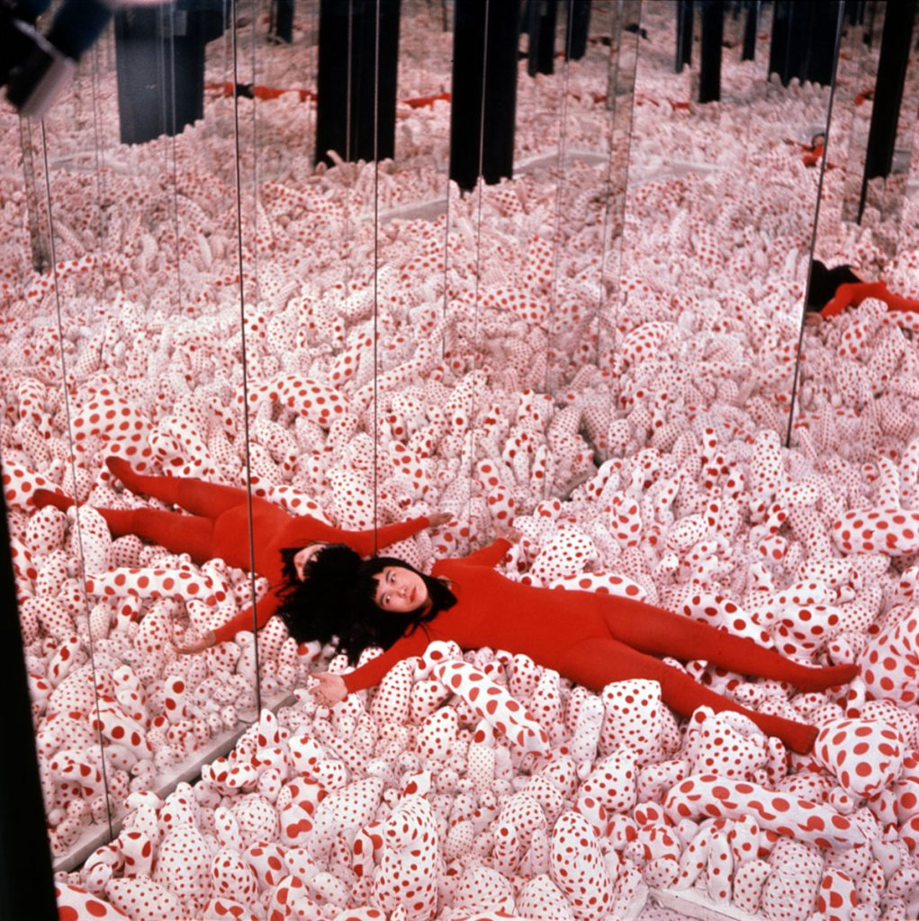
Yayoi Kusama (Japanese, b. 1928) Infinity Mirror Room, Phalli’s Field, 1965 installation, New York. Post-Minimalism. Room lined with mirrors and carpeted with hundreds of polka-dotted fabric protrusions that Kusama called “a sublime, miraculous field of phalluses”

Slide 27
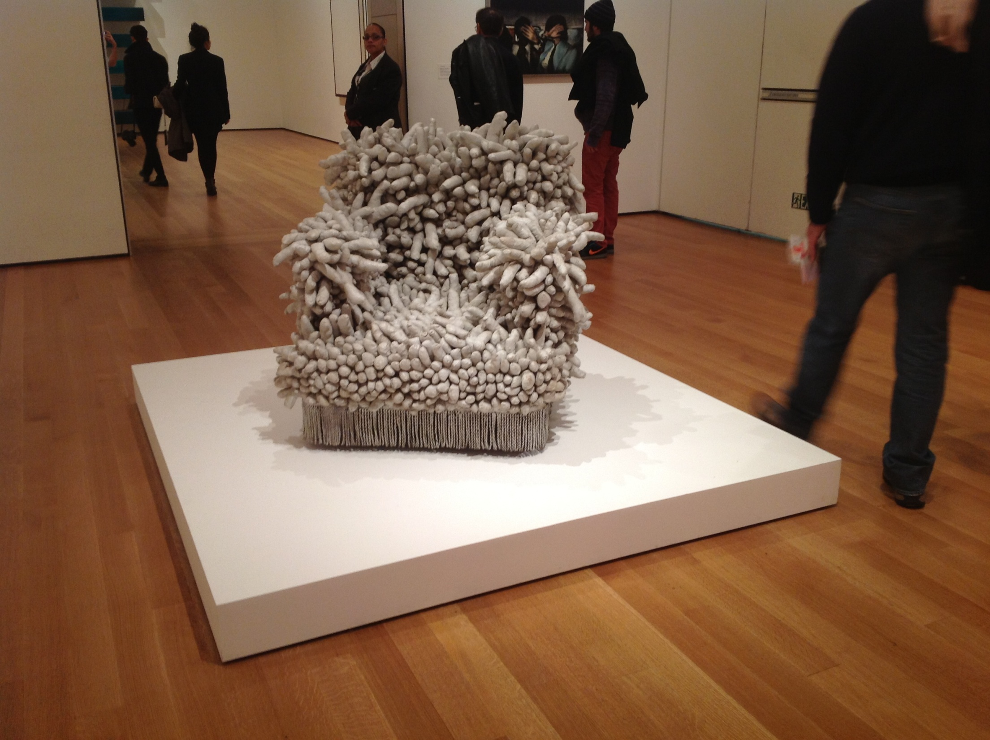
Yayoi Kusama, Accumulation #1, 1962, sewn stuffed fabric, paint, and chair fringe, Museum of Modern Art
NYC, 2012 acquisition

Slide 28
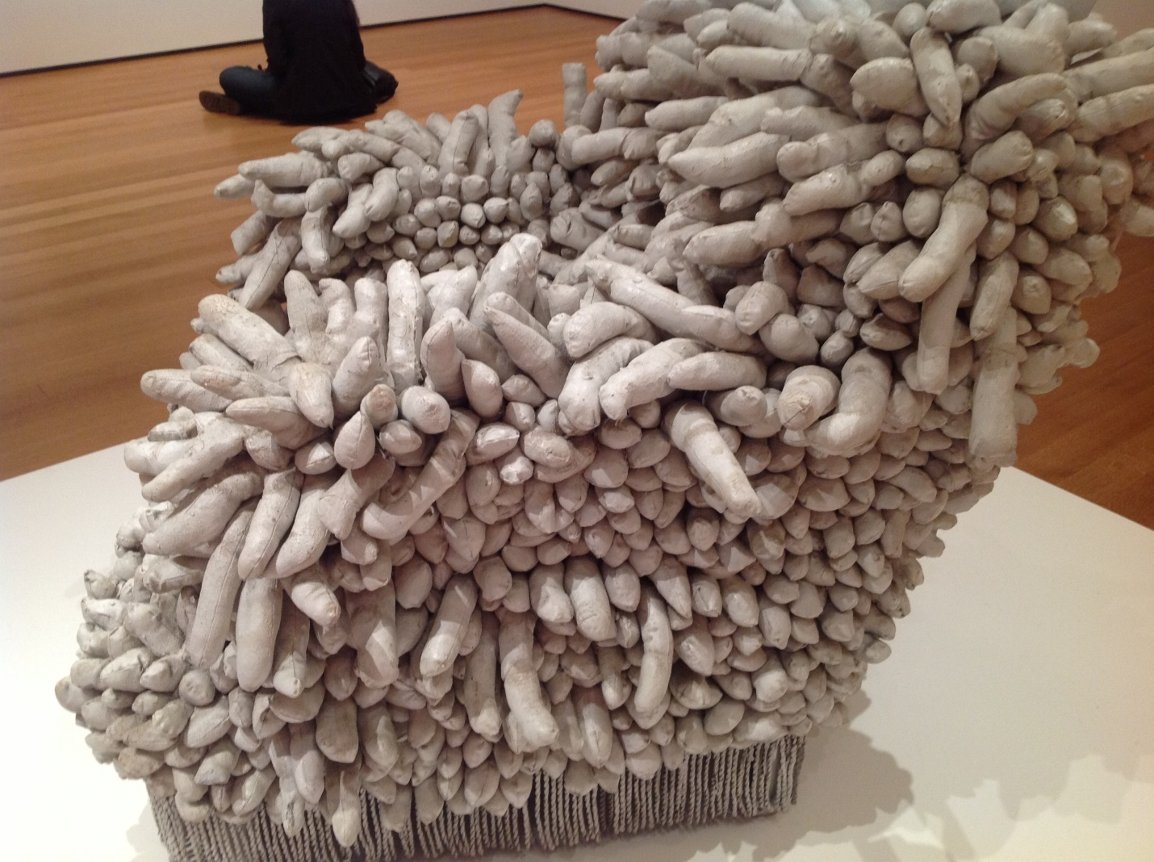
Kusama, Accumulation #1, 1962, sewn stuffed fabric
paint and chair fringe, Museum of Modern Art
NYC, 2012 acquisition

Slide 29
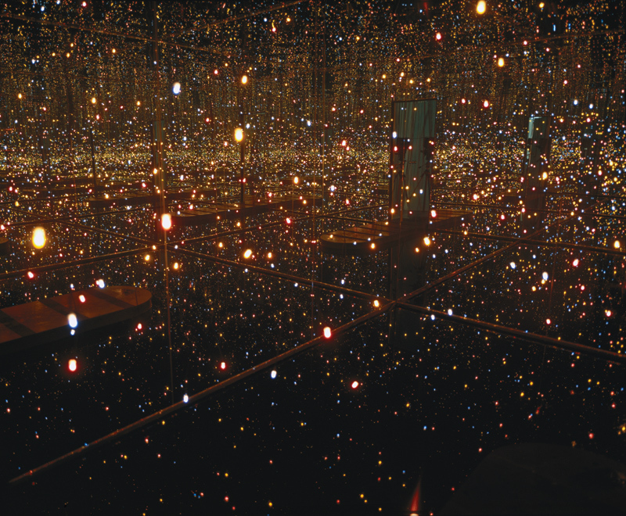
Yayoi Kusama, Fireflies on the Water, 2002. Mirror, plexiglass, 150 lights and water, 111 × 144 1/2 × 144 1/2 in. overall. Whitney Museum of American Art, New York

Slide 30
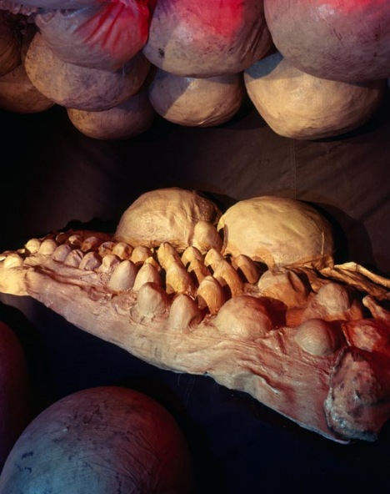
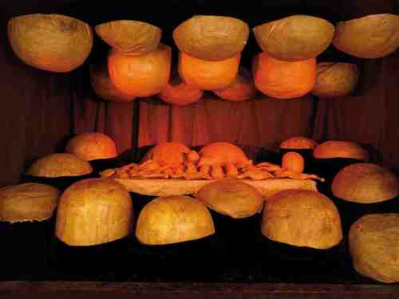
Louise Bourgeois (French American, 1911-2010), The Destruction of the Father, 1974, plaster, latex, wood & fabric, 93 x 142 x 97” The artist describes the narrative of this piece as “The children grabbed him [the father] and put him on the table. And he became the food. They took him apart, dismembered him. Ate him up. And so he was liquidated…the same way he liquidated his children. The sculpture represents both a table and a bed.”

Slide 31
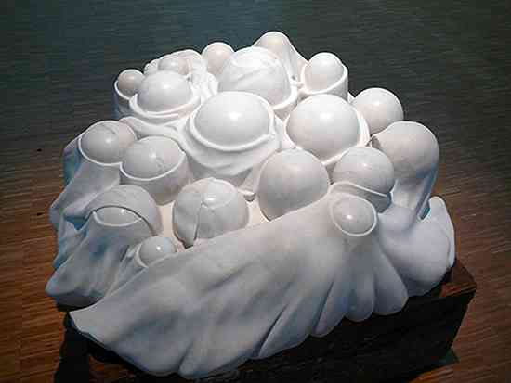
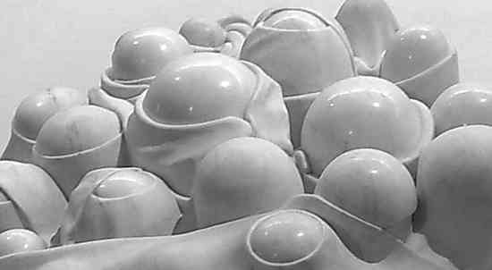
Louise Bourgeois, Cumul I, 1969, marble on wood base, 2’ x 4’ x 4’ with detail below. Placed on floor to be seen from above.

Slide 32
Louise Bourgeois, Spider, steel and mixed media, 1996
In 2011 one of her Spider works sold for $10.7 million, a new record price
for the artist at auction, and the highest price paid for a work by a woman artist.

Slide 33
Louise Bourgeois, Maman, 35 ft H,
Tate London, 1999

Slide 35
Tara Donovan (American, b. 1969) Untitled (Plastic cups), 2006, thousands of transparent plastic cups in a tight grid, stacked into curves and waves. (The work is re-made each time it is shown and can be expanded or contracted to fit the space.) This can be called “Post-Minimal.” Why?

Slide 36
Tara Donovan, Untitled (Plastic Cups) 2000 installation

Slide 37
Tara Donovan, Untitled (Glass), 2006. Sheets of stacked tempered glass; one corner of each pane is struck with a hammer and shattered into tiny pieces that stay in place. “If you bump into this and knock a corner off it, it can’t be repaired or remade with the same materials. It has to be made over again.” When the show is over, "it gets taken away with a shovel.”

Slide 38
Tara Donovan, Untitled (Styrofoam cups), 2006 installation

Slide 39
Janine Antoni (US. b. Bahamas, 1964) Gnaw, 1992, Postminimal Antoni used her mouth and the activity of eating or chewing to carve two 600 lb. cubes, one made of chocolate, the other of lard.

Slide 40
Janine Antoni, Gnaw, 1992: (left) display case with 45 heart-shaped packages for chocolate made from chewed chocolate removed from the chocolate cube and 400 lipsticks made with pigment, beeswax and chewed lard removed from the lard cube
http://www.pbs.org/art21/watch-now/segment-janine-antoni-in-loss-desire

Slide 41
Do Ho Suh (Korea b. 1962), Staircase-III, Tate Modern, London, 2011

Slide 42
Ai Weiwei (China b. 1957), Sunflower Seeds, conceptual, post-minimal installation, October 2010 - May 2011, Tate Modern, London

